Slide 1

Sprocket Central Pty Ltd
Data analytics approach
Swarnim Mahendra - Junior Consultant

Slide 2
Agenda
1.
2.
3.
4.
Introduction
Data Exploration
Model Development
Interpretation

Slide 3
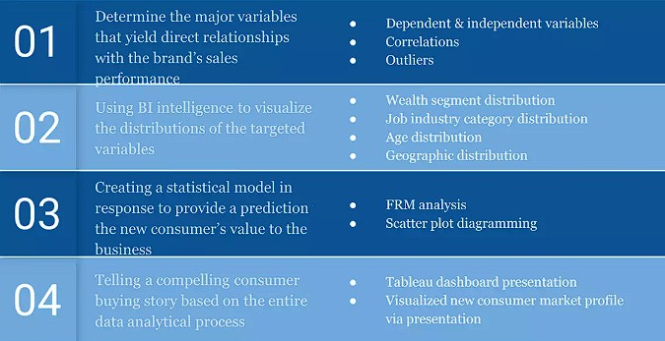
Introduction
Goal of our Task :
Boost the company’s business by analyzing the existing customer demographic dataset to find the purchases done by different age groups.
To provide a recommendation regarding the newly recorded 1000 customers who should be targeted to reinforce the company’s performance in order to present a highly visualized data-driven target market profile.

Slide 4
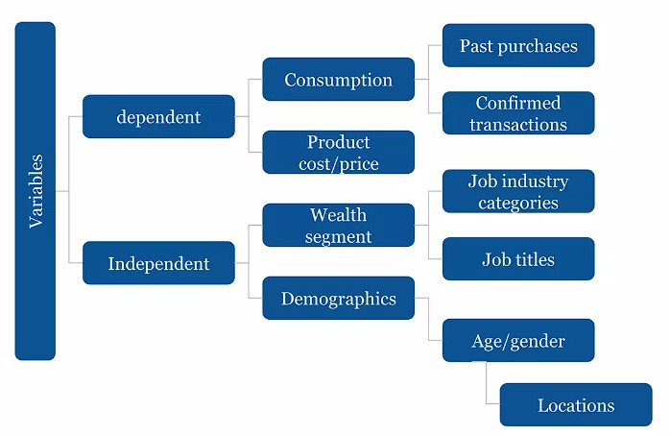
Data Exploration
Major Variables :
Understand in detail the underlying data’s properties for each field, such as variable distribution: Dependent or Independent.
There are some limitations in the given datasets like Missing values, Data-types, Incomplete data, etc.
The necessary data must be transformed and unwanted data should be removed, in such a way that it is in analysis-friendly-manner

Slide 5
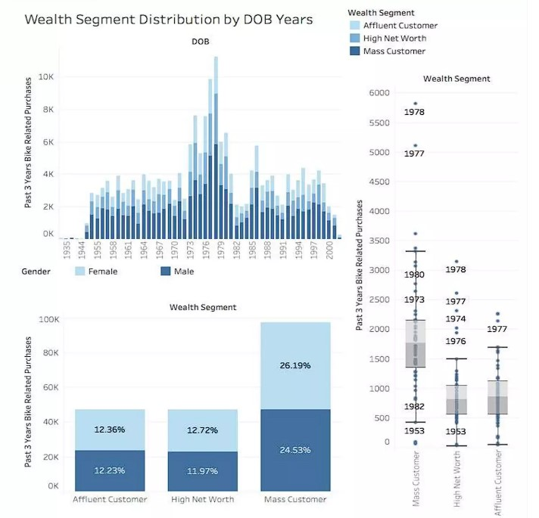
Data Exploration
Wealth Segment & Distribution:
Key variables involved:
Confirmed past 3 years purchases
Wealth Segmentation
DOB of recorded customers
Gender Types.
Critical Takeaways:
The most needed customer base can be categorized as a segment of mass customer
Female customers across different wealth segments will be the major buying power.
Customers between the age 40 to 50 years old will have the biggest buying potential.

Slide 6
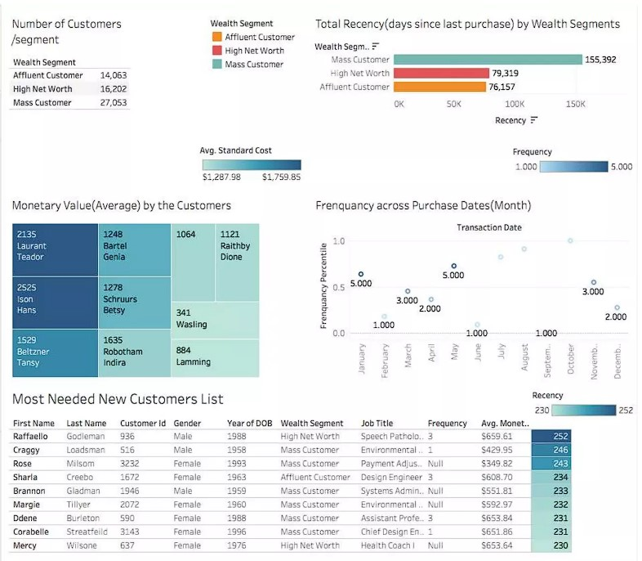
Model Development
RFM Model:
The RFM model is implemented in response to classify the customer base by segments in detail and filter out the most needed segment that the company should target.
Mass customer segment will become a major customer base that the company should invest in according to purchase recency, frequency & monetary.

Slide 7
Interpretation
RFM Model Elements & Results
The more recent the customer visits are, the higher the customer retention will be.
The more frequent the purchase per customer is, the higher level of customer loyalty will be.
The big-spending customers generally spend over an average $580 per transaction for bike-related products.

Slide 8
Thank You

